Slide 1

Shodan in the Atlantic
Grant Boudreau & Sunny Jamwal

Slide 2

Agenda
Introduction
Shodan
Common Ports
Operating Systems
IOT Devices
Database Servers
Recommendations
Q&A
Notes:
GRANT

Slide 3
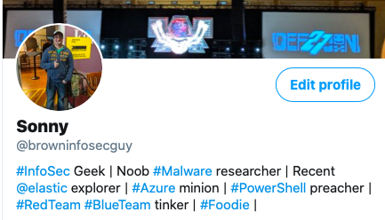
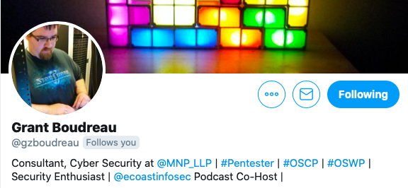


Sunny Jamwal & Grant Boudreau
Notes:
Sunny
Grant

Slide 4

Shodan
Shodan is a search engine for everything and anything on the internet.
It crawls the internet to find devices and potential vulnerabilities
Helps defenders see what is exposed online so they can fix and increase their security posture
Helps attackers see potential entry points during a red team/pentest engagement
Notes:
Grant

Slide 5
FTP - PORT 21 / Telnet - Port 23
Notes:
Sunny

Slide 6
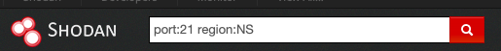
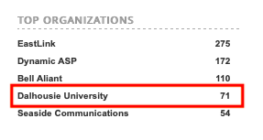
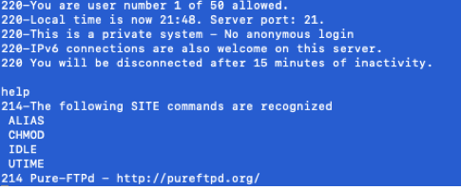
FTP - PORT 21 Nova Scotia
Notes:
Sunny

Slide 7
Telnet - port 23 - pei
Notes:
Grant

Slide 8

Telnet - port 23 - pei
Notes:
Grant

Slide 9
FTP - port 21 - New Brunswick
Notes:
sunny

Slide 10

FTP - PORT 21 - New Brunswick
Notes:
sunny

Slide 11
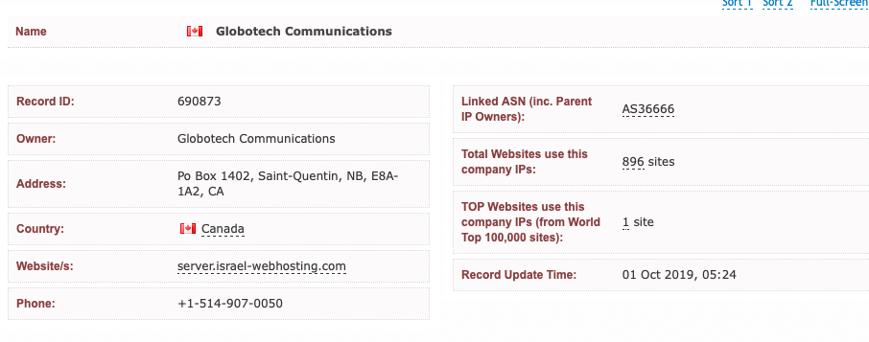
FTP - PORT 21 - New Brunswick
Notes:
sunny

Slide 12
SSH – Port 22
Notes:
grant

Slide 13
SMTP – Port 25
Notes:
sunny

Slide 14
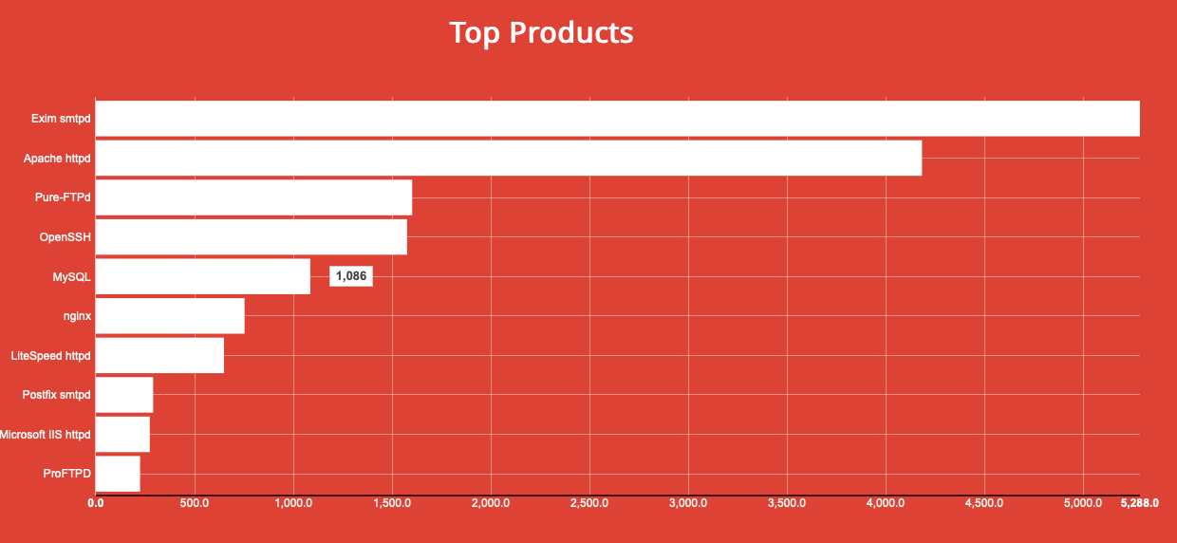
SMTP – Port 25
Notes:
sunny

Slide 15
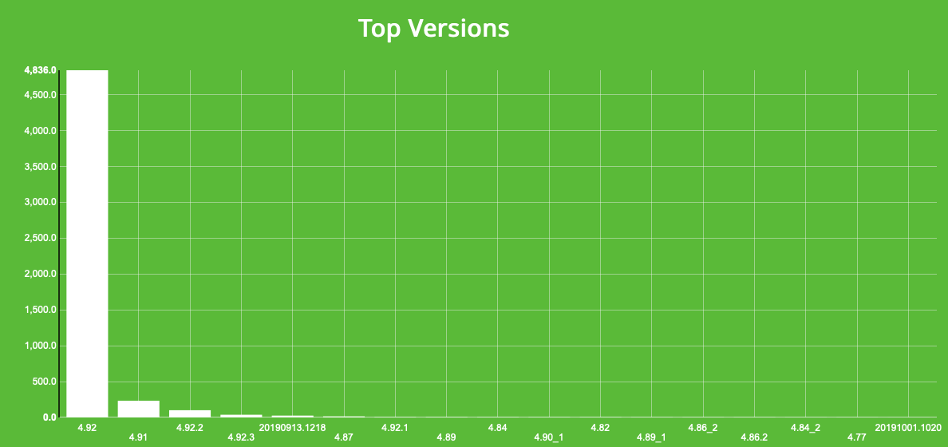
SMTP – Port 25
Notes:
sunny

Slide 16
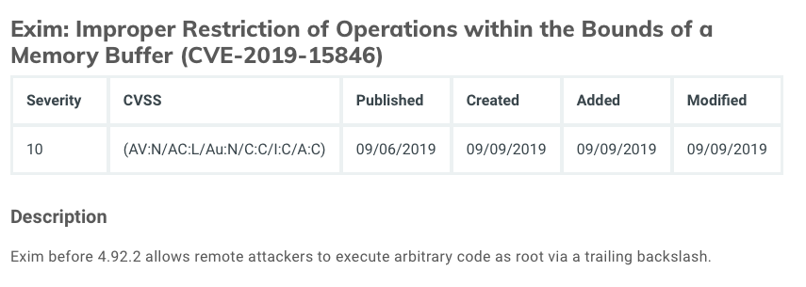
SMTP – Port 25
Notes:
sunny

Slide 17
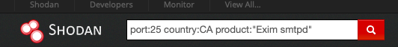
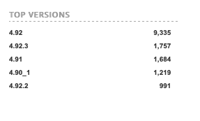
SMTP – Port 25
Notes:
sunny

Slide 18
DNS – Port 53
Notes:
grant

Slide 19
HTTP – Port 80 / HTTPS – Port 443
Notes:
grant

Slide 20
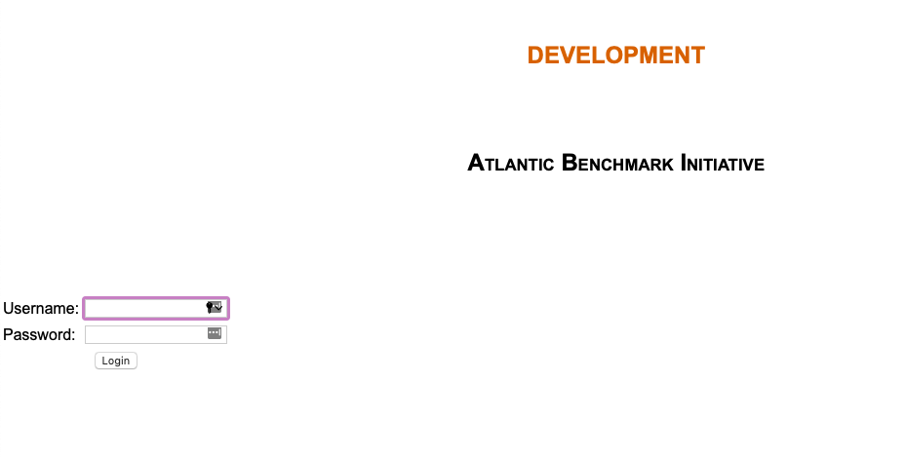
HTTP – Port 80 / HTTPS – Port 443 - New Brunswick
Notes:
grant

Slide 21
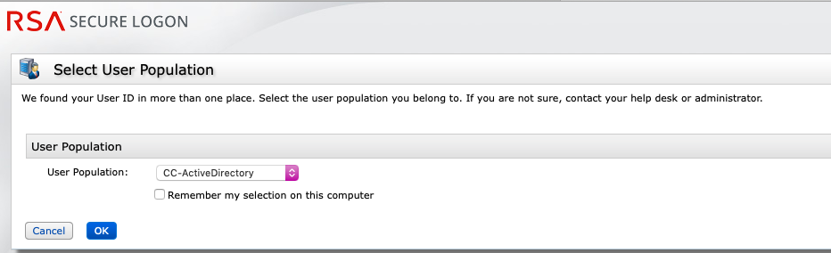
HTTP – Port 80 / HTTPS – Port 443 - New Brunswick
Notes:
grant

Slide 22
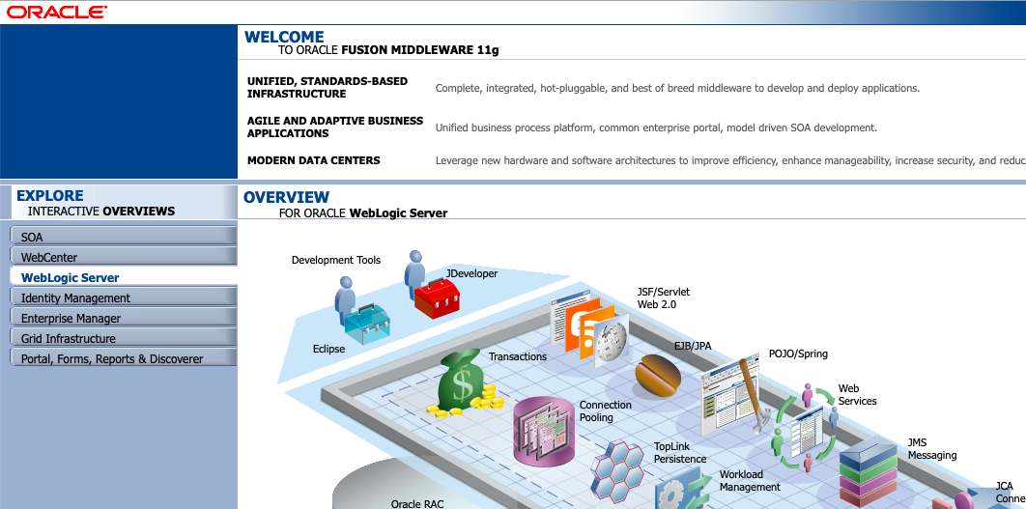
HTTP – Port 80 / HTTPS – Port 443 - New Brunswick
Notes:
grant

Slide 23
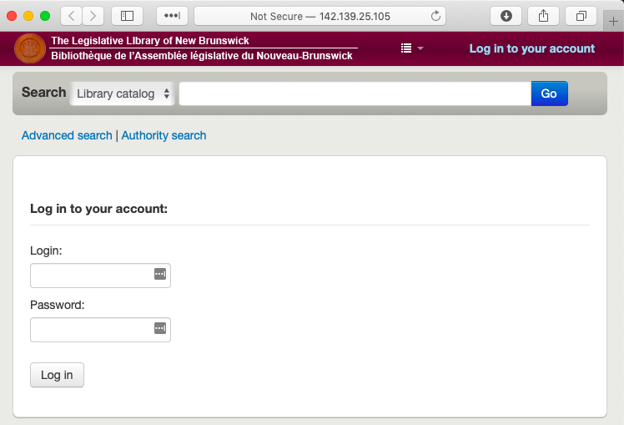
HTTP – Port 80 / HTTPS – Port 443 - New Brunswick
Notes:
grant

Slide 24
POP3 – Port 110
Notes:
Grant sunny

Slide 25
IMAP – Port 143
Notes:
Grant sunny

Slide 26
SNMP – Port 161
Notes:
Grant sunny

Slide 27
SMB – Port 445
Notes:
Grant sunny

Slide 28
RDP – Port 3389
Notes:
Grant sunny

Slide 29
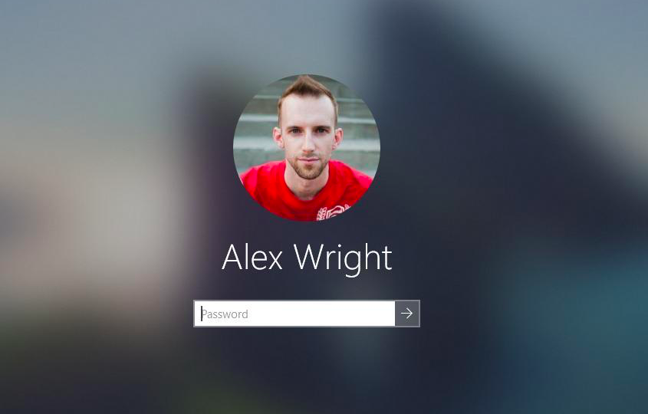
RDP – Port 3389
Notes:
sunny

Slide 30
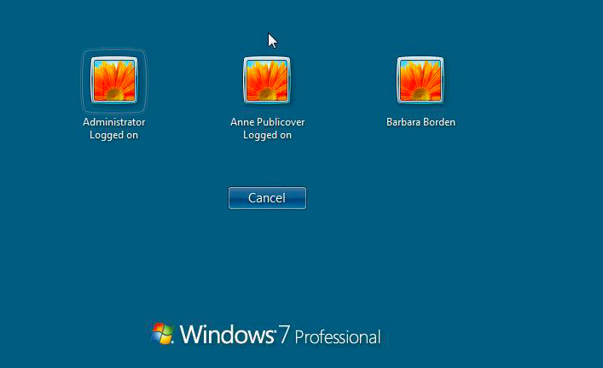
RDP – Port 3389
Notes:
sunny

Slide 31
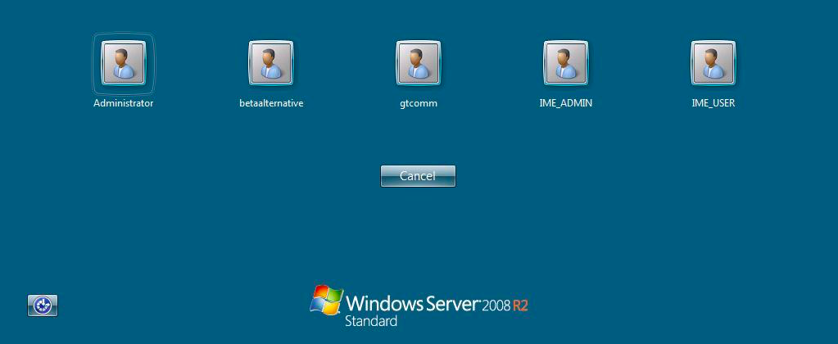
RDP – Port 3389
Notes:
sunny

Slide 32
Tomcat – Port 8080
Notes:
grant

Slide 33
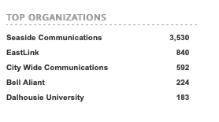
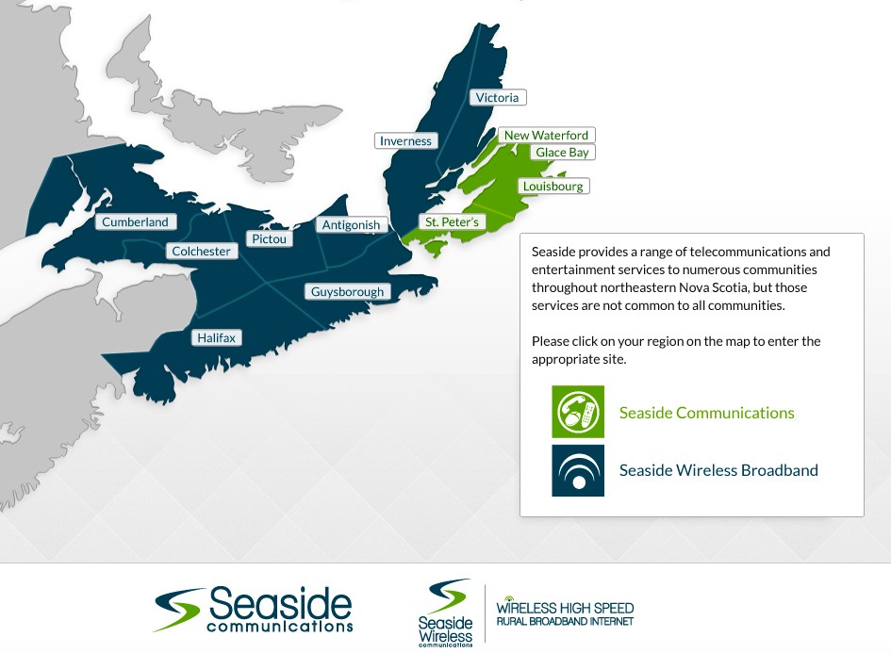
Tomcat – Port 8080
Notes:
grant

Slide 34
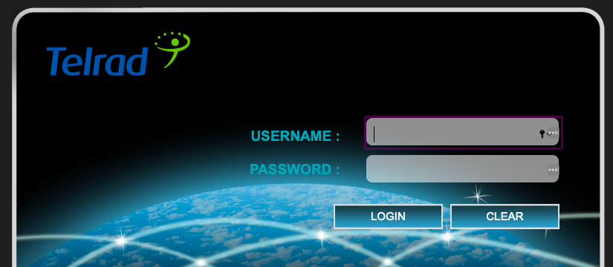
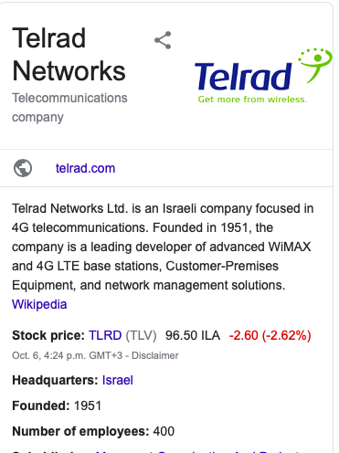
Tomcat – Port 8080
Notes:
grant

Slide 35
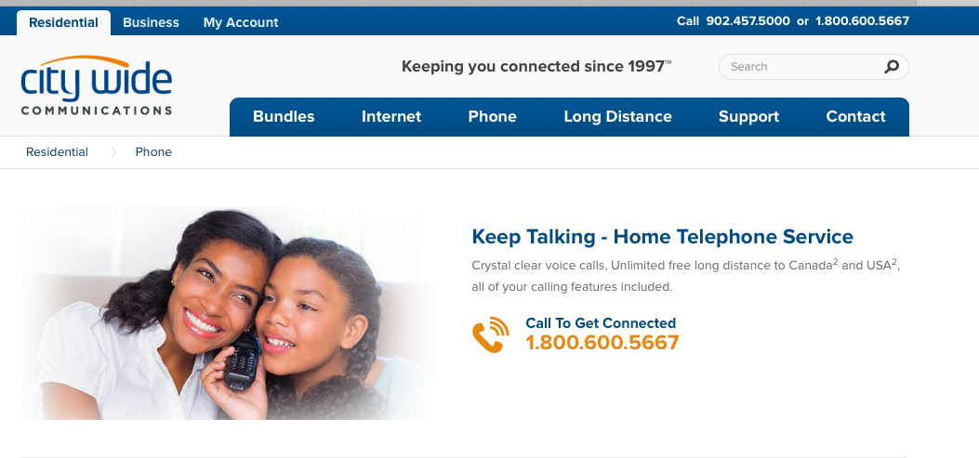
Tomcat – Port 8080
Notes:
grant

Slide 36
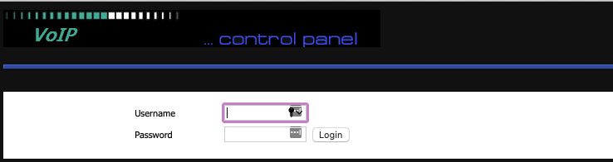
Tomcat – Port 8080
Notes:
grant

Slide 37
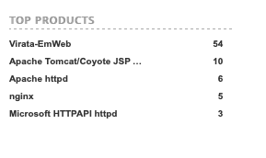

Tomcat – Port 8080
Notes:
sunny

Slide 38
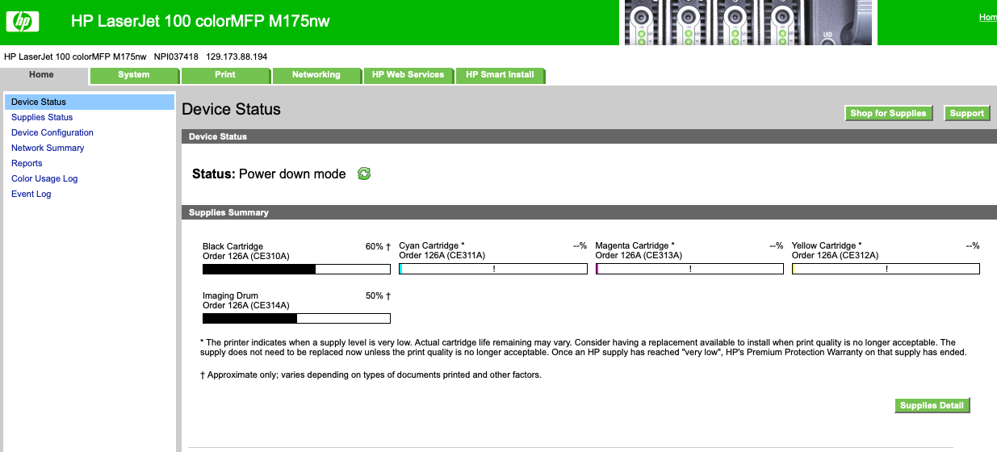
Tomcat – Port 8080
Notes:
sunny

Slide 39
Windows 7 and 2008
Notes:
grant

Slide 40
Linux kernel
Notes:
grant

Slide 41

IOT Devices
Type to enter a caption.
Notes:
sunny

Slide 42
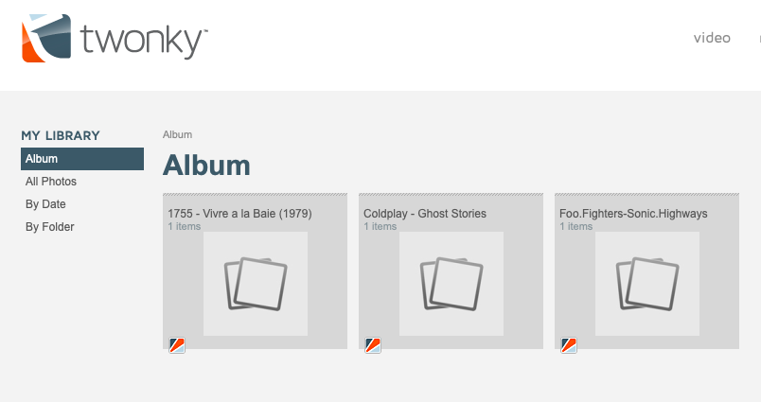
IOT Devices
Type to enter a caption.
Notes:
sunny

Slide 43
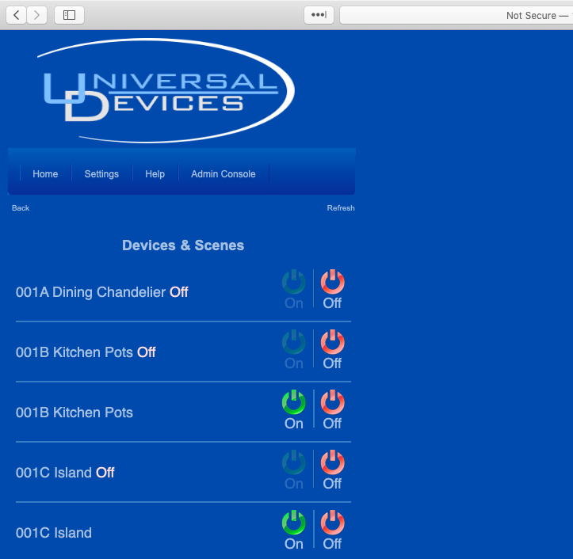

IOT Devices
Notes:
sunny

Slide 44
MySQL - NEW Brunswick
Notes:
grant

Slide 45
MySQL - Nova Scotia
Notes:
Grant sunny

Slide 46
Recommendations
Segment the network according to function, department, geographic location, level of security, or any other logical separation (taking contractors, third-party vendors, and others into account).
Implement log analysis for threat detection and remediation, and building threat intelligence; the data can be fed into Security Information and Event Management (SIEM) software and help the response team understand ongoing attacks.
Properly configure user access profiles, workstations, and servers, including internet-connected devices using the least-privilege model.
Implement an End Point Detection and Response (EDR) solution to detect and mitigate threats.
Collect external threat intelligence along with EDR data acted upon by knowledgeable human analysts who can determine through identifying patterns in attacker’s tools, tactics, and procedures (TTPs), if an attack is ongoing inside the network.
Configure alerts in Shodan specific to your organization.

Slide 47

QUESTIONS!!!

